Slide 1
Python based Shaderpipeline in VRED
Notes:
How to implement and use shader pipelines in VRED
Implement one simple material mapper, but also one that is a little more complex
Python scripting

Slide 2
Ideenkultivierung GmbH
3D-Design
Interactive Visualization
Software-Development
Trainings (e.g. CAD, VRED, Scripting)
Notes:
Software Developer for 7 years
Automotive, Technical Visualizations
Self-Employed with focus on 3D Visualization
Co-Founder of Ideenkultivierung with Christian Wölfel
3D-Design
Renderings
Videoproduction
Interactive Visualization, WebGL,
Software-Development
Websites and Apps
Pipeline Development
Product Configurators
…
Trainings and Consulting (e.g. CAD, VRED, Scripting)
We use a broad range of tools like Unity, Unreal or VRED to finish our projects.

Slide 3
Ideenkultivierung GmbH
[Screenshots von Website]
Notes:
Software Developer for 7 years
Automotive, Technical Visualizations
Self-Employed with focus on 3D Visualization
Co-Founder of Ideenkultivierung with Christian Wölfel
3D-Design
Renderings
Videoproduction
Interactive Visualization, WebGL,
Software-Development
Websites and Apps
Pipeline Development
Product Configurators
…
Trainings and Consulting (e.g. CAD, VRED, Scripting)
We use a broad range of tools like Unity, Unreal or VRED to finish our projects.

Slide 4
[VRED Shading Demo]
Notes:
Design Process
Design Vehicle Parts
Evaluate Vehicle Parts
Change Design
Start over
In between iterations:
Transform unshaded CAD file into shaded file
For use in presentations, to use it in VR
Time consuming process
Error-prone
frustrating

Slide 5
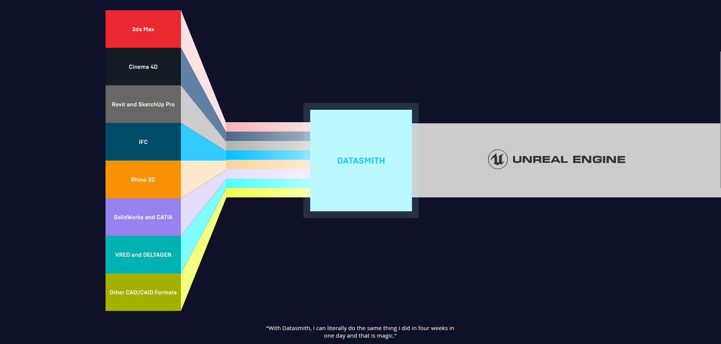
Examples in the wild
Notes:
There are examples of other shader pipelines
Data Smith for Unreal Engine:
Import a wide range of file formats
Automatically create Unreal Materials
But: Materials still have to be replaced or manually adjusted

Slide 6
Implementing Shaderpipelines in VRED
Use an automated shaderpipeline in VRED to do the time consuming work
Automatically apply materials by using material libraries
Use color coded base-materials or material names to shade the model
Use fuzzy matching to shade even faster
Notes:
How can we implement a shaderpipeline in VRED?
Use an automated shaderpipeline to do the time consuming work
Automatically apply materials by using material libraries
Use color coded base-materials or material names to shade the model
Use fuzzy matching to shade even faster
These are the questions I will try to answer for you

Slide 7
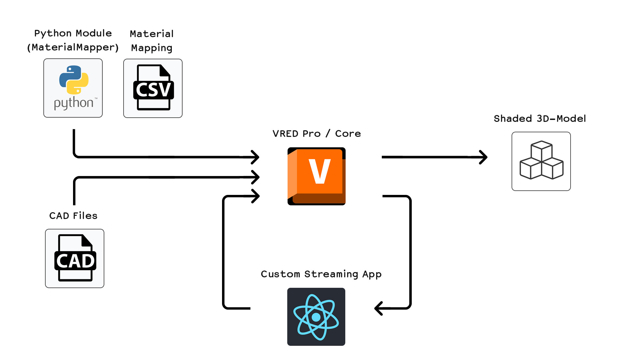
Project Overview
Notes:
Setup for this Demonstration
VRED Pro as the main Part
VRED Streaming App to control pipeline
React Web App (Streaming App)
Based on VRED Streaming App
HTML Interface to send commands to VRED
See results in Real Time
But: Could be just scripts, could be fully automated, could be a plugin in VRED, …
Python modules (MaterialMapper)
Includes all functions related to material mapping
Imported as python module into VRED
Functions can be triggered from VRED or from outside
Mapping tables
Define how to transform CAD materials into VRED materials
Today: Only the material mapping part is discussed

Slide 8
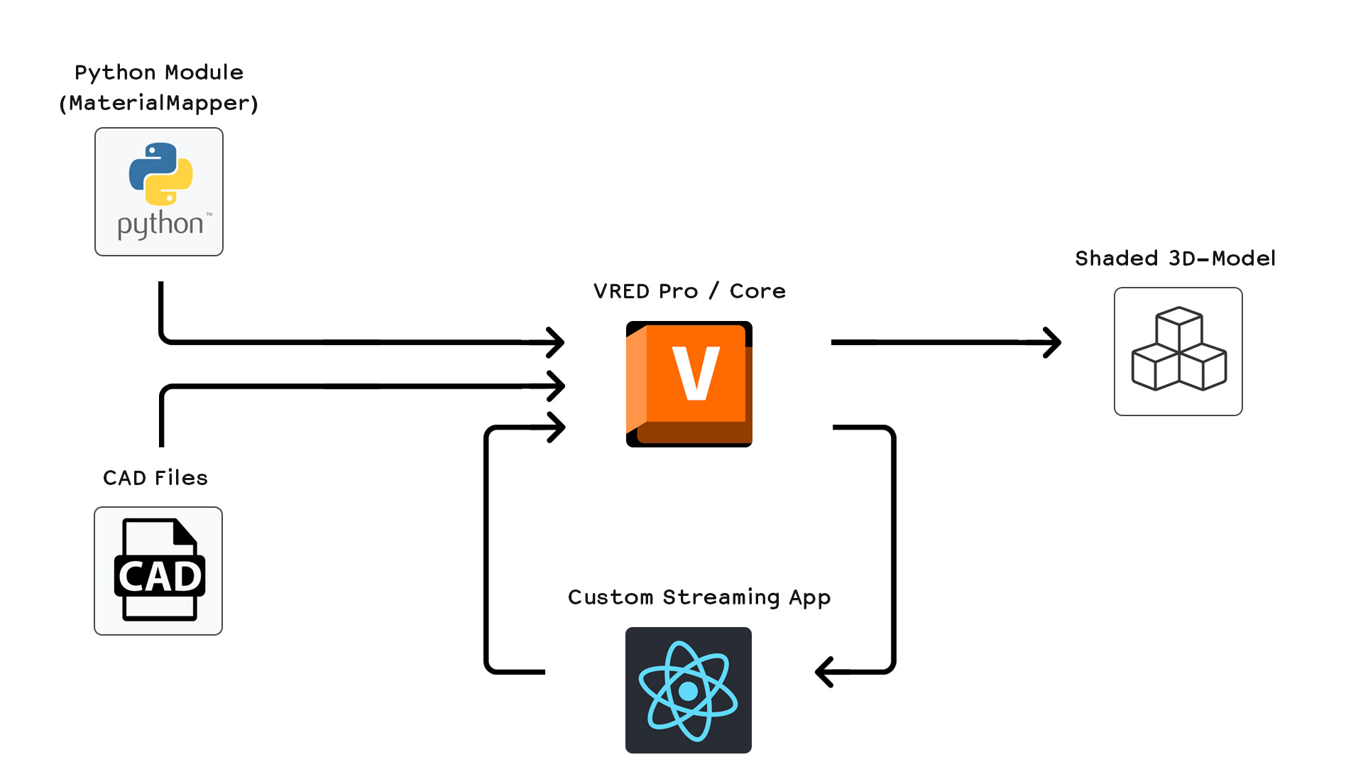
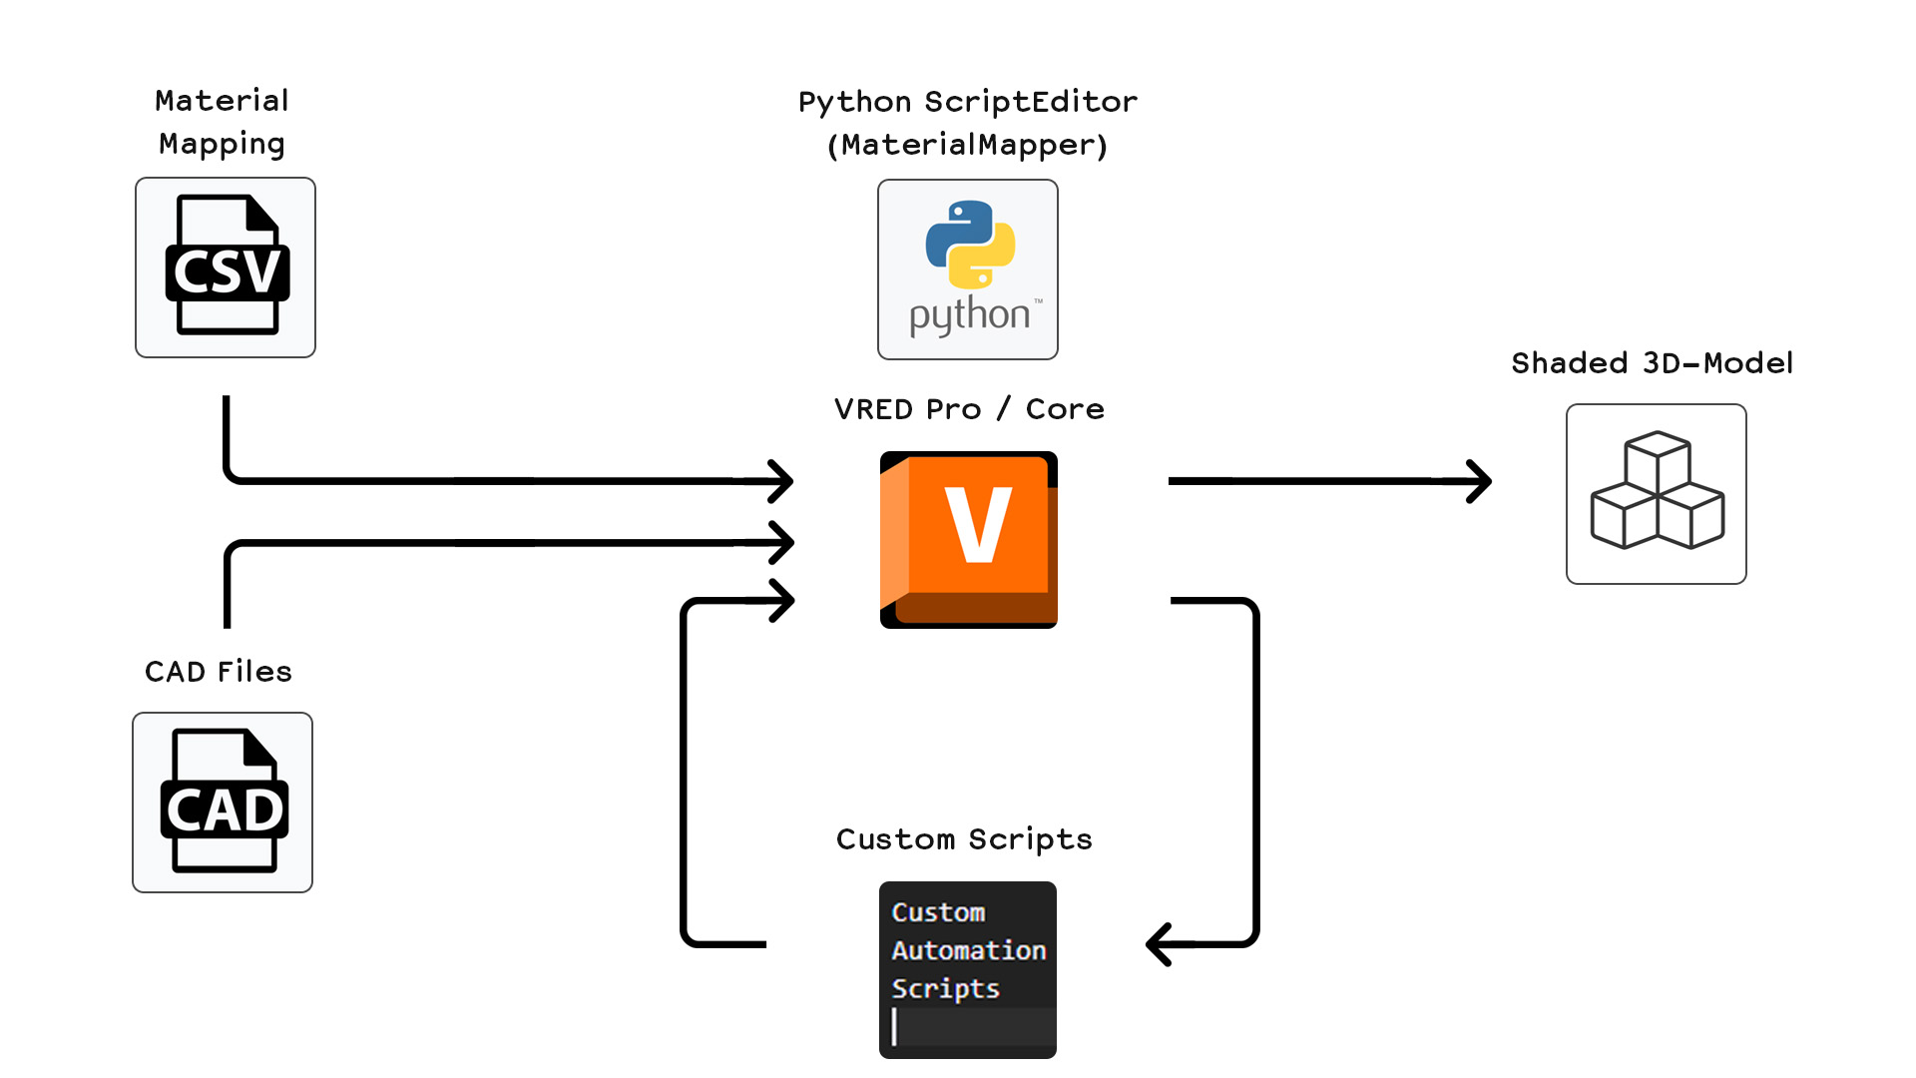
Project Overview
Notes:
There are different approaches to setup a pipeline in VRED
Always includes Python Scripts to do the work
Control Interface (Streaming App, Script, Variantsets, etc.)
Additional Data (Lookup Tables for materials)
No solution that fits all needs, therefore can be complicated at first
Every company has other requirements
Different IT-Infrastructures
Advantage is, that it is very customizable
Not limited to shading
All kinds of optimizations are possible

Slide 9
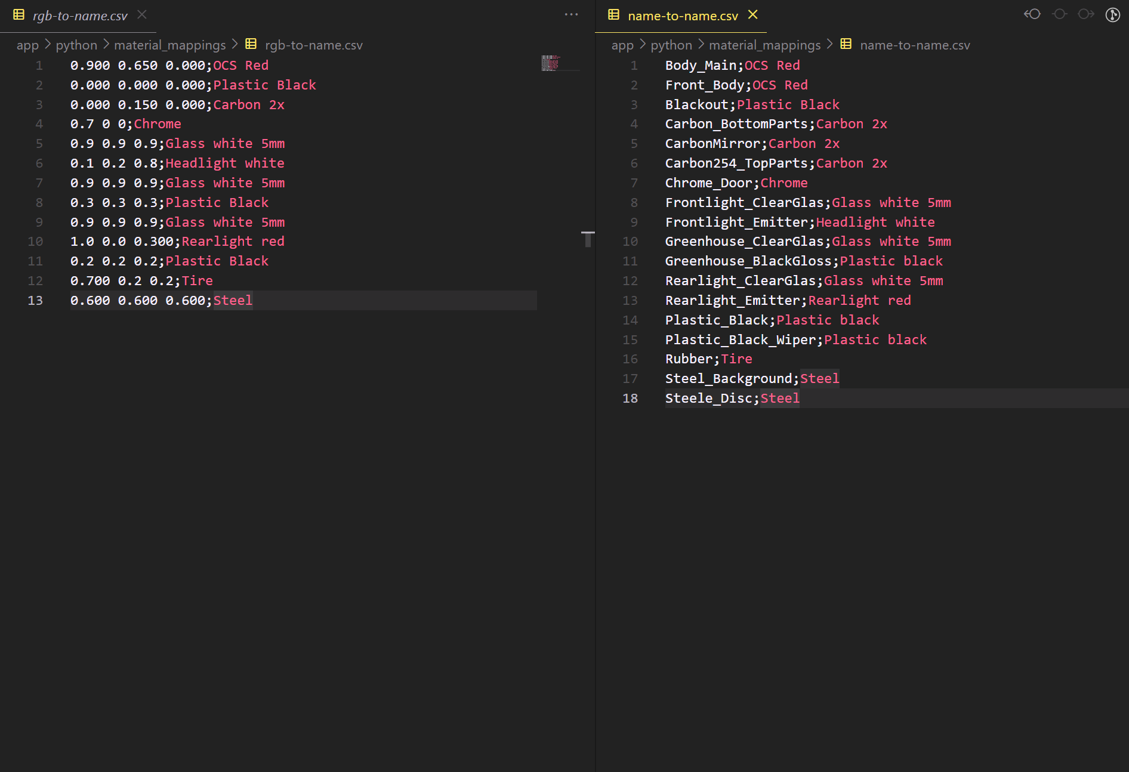
Notes:
Just to give you an idea how a mapping table for materials can look like

Slide 10
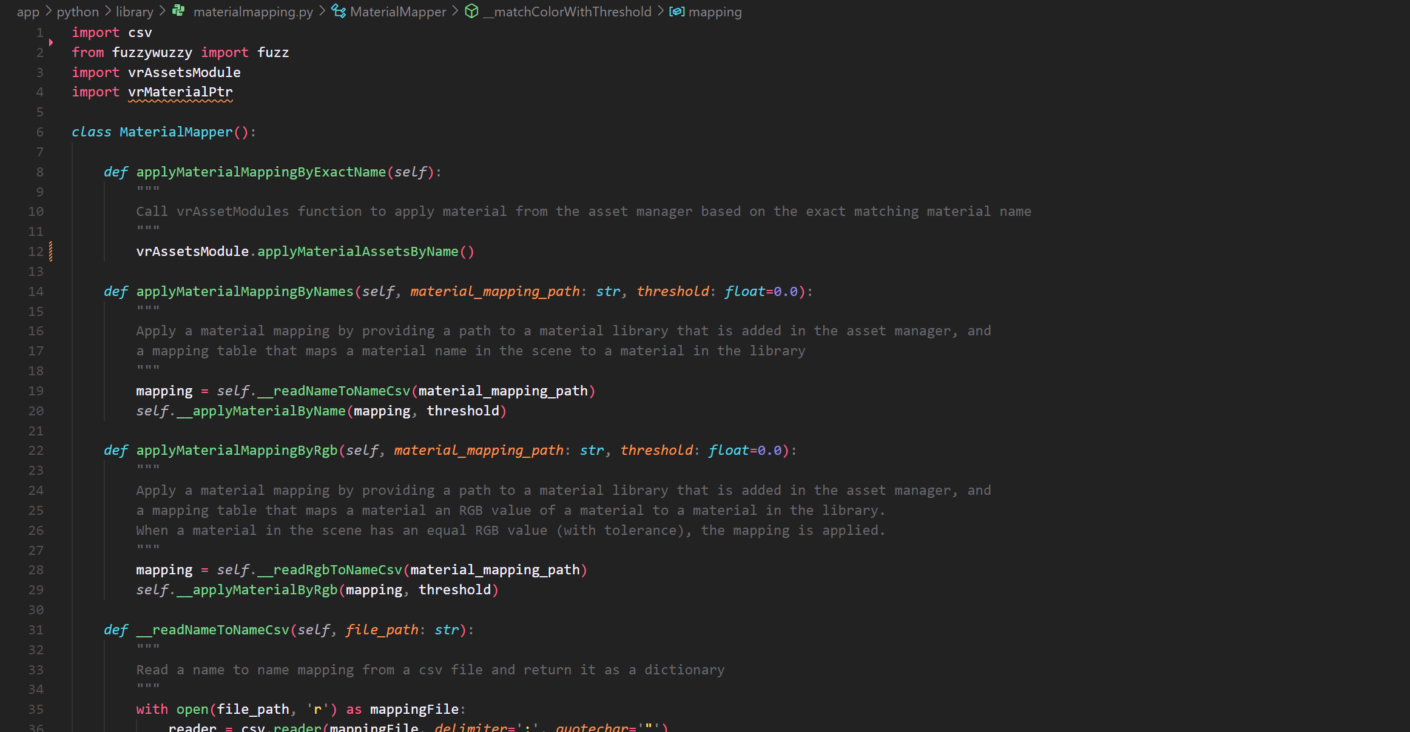

Slide 11
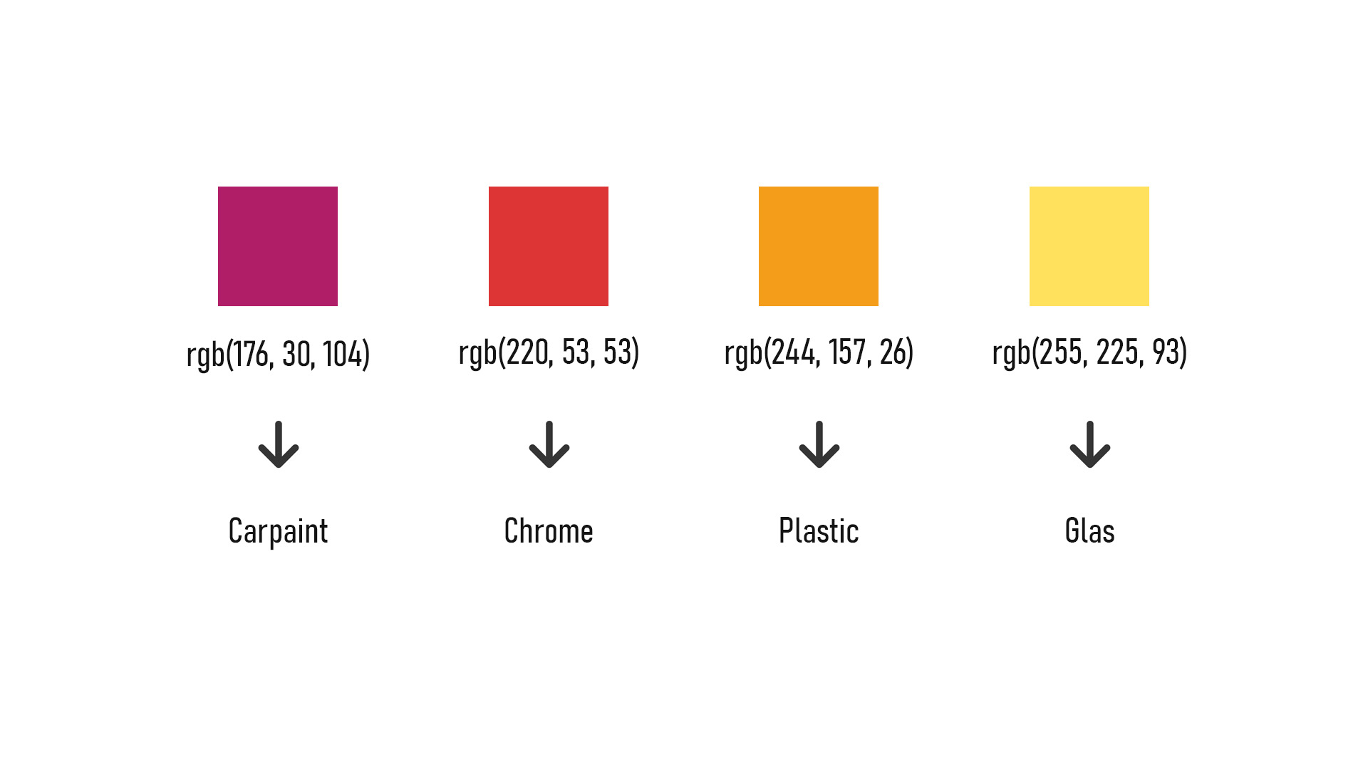
Prerequisits: Common Standards
Notes:
Agree on material naming conventions or RGB-color values (most-general case)

Slide 12
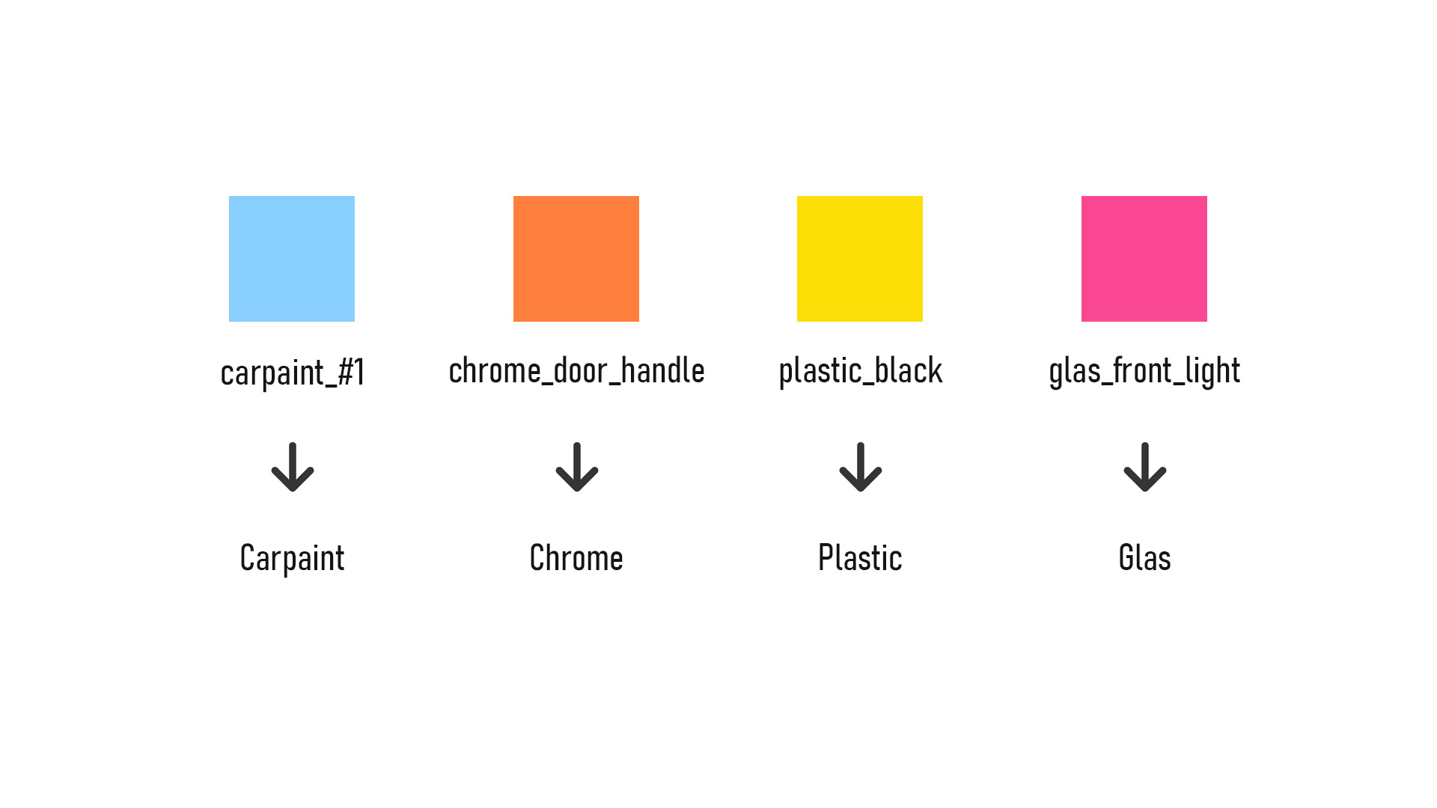
Prerequisits: Common Standards
Notes:
Agree on material naming conventions or RGB-color values (most-general case)

Slide 13
[VRED Shading Demo]
Notes:
Look at all materials in the imported file
Get the RGB values of the diffuse channel using the field access
Use lookup table to find a matching color
If there is a matching color -> replace material!

Slide 14
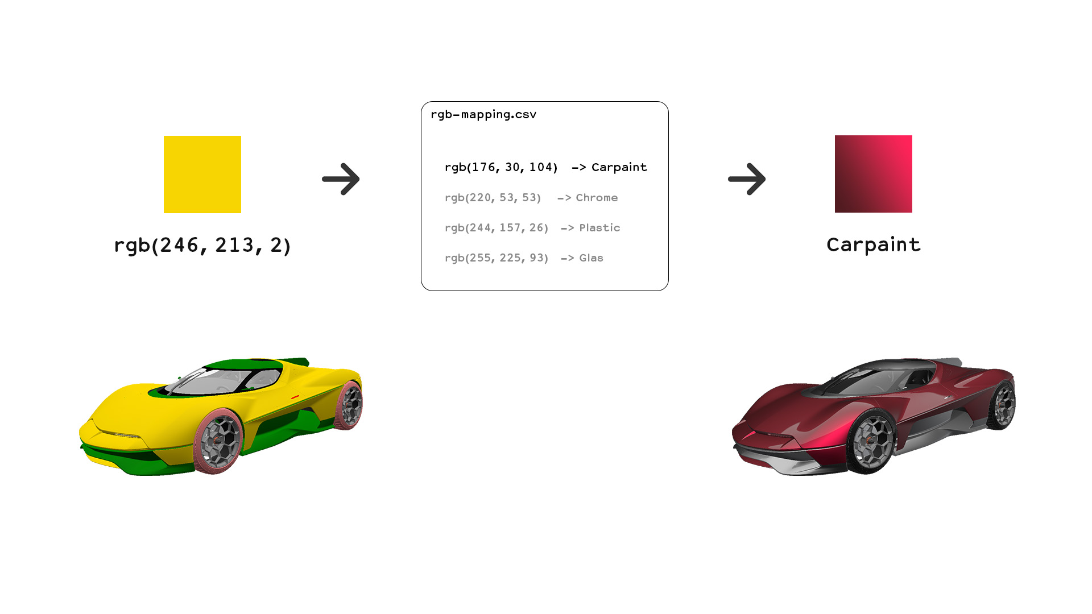
Notes:
Look at all materials in the imported file
Get the RGB values of the diffuse channel using the field access
Use lookup table to find a matching color
If there is a matching color -> replace material!
The process is basically the same for matching material names
Look at all materials in the imported file
Get the name of the material
Use lookup table to find a matching name
If there is a matching name -> replace material!

Slide 15
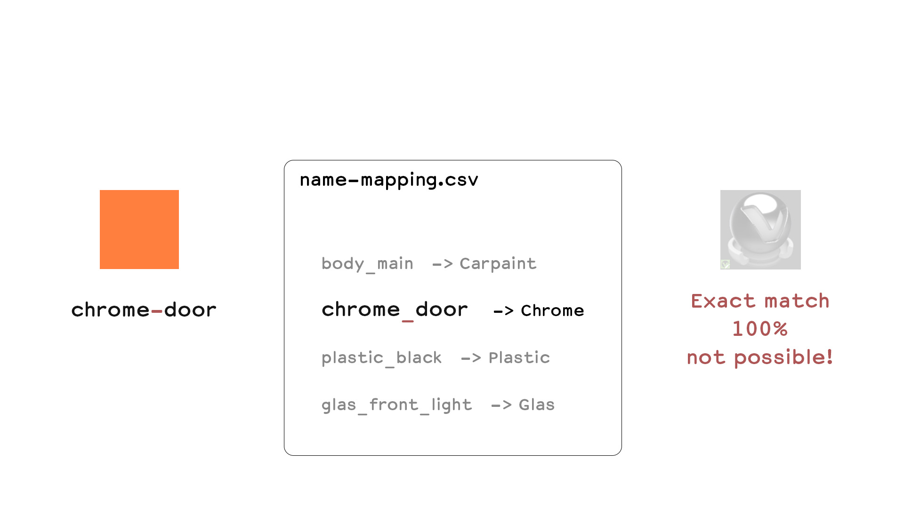
Fuzzy Matching
Notes:
Fuzzy Matching: Find also matches that are not 100% correct
Making errors is human
RGB values are off by a few percent
Material names have spelling errors
Fuzzy Matching calculates a ratio on how similar two things are
Helpful when doing fast iterations where not everything is correctly set up
Keep working while a colleague fixes materials at the source
Prevent manual fixing of shading problems

Slide 16
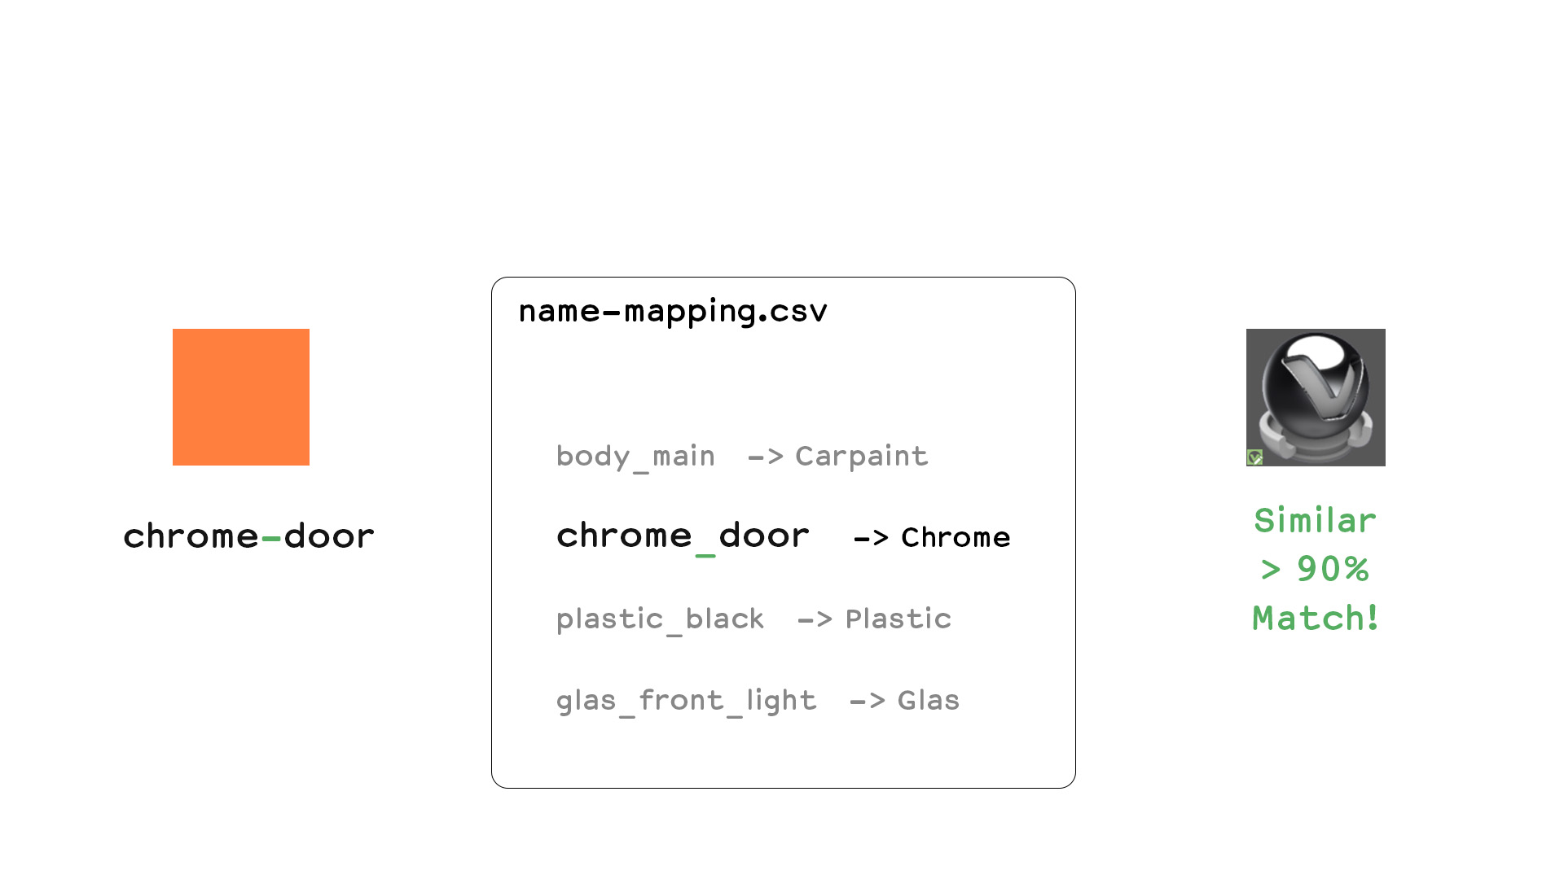
Fuzzy Matching
Notes:
Fuzzy Matching: Find also matches that are not 100% correct
Making errors is human
RGB values are off by a few percent
Material names have spelling errors
Fuzzy Matching calculates a ratio on how similar two things are
Helpful when doing fast iterations where not everything is correctly set up
Keep working while a colleague fixes materials at the source
Prevent manual fixing of shading problems

Slide 17
[VRED Shading Demo]
Notes:
Look at all materials in the imported file
Get the RGB values of the diffuse channel using the field access
Use lookup table to find a matching color
If there is a matching color -> replace material!

Slide 18
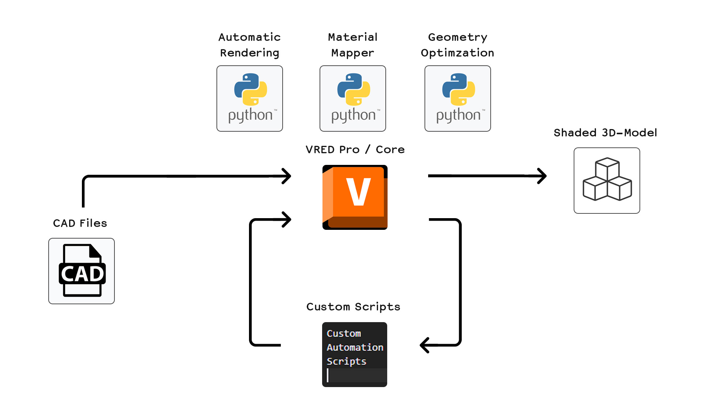
Notes:
Automatically Optimize for VR
Merge geometries
Merge materials
Use special material libraries with VR-optimized materials
Reduce hierarchy depth
Automatically sort hierarchy based on materials

Slide 19
Backup
Notes:
Look at all materials in the imported file
Get the RGB values of the diffuse channel using the field access
Use lookup table to find a matching color
If there is a matching color -> replace material!

Slide 20
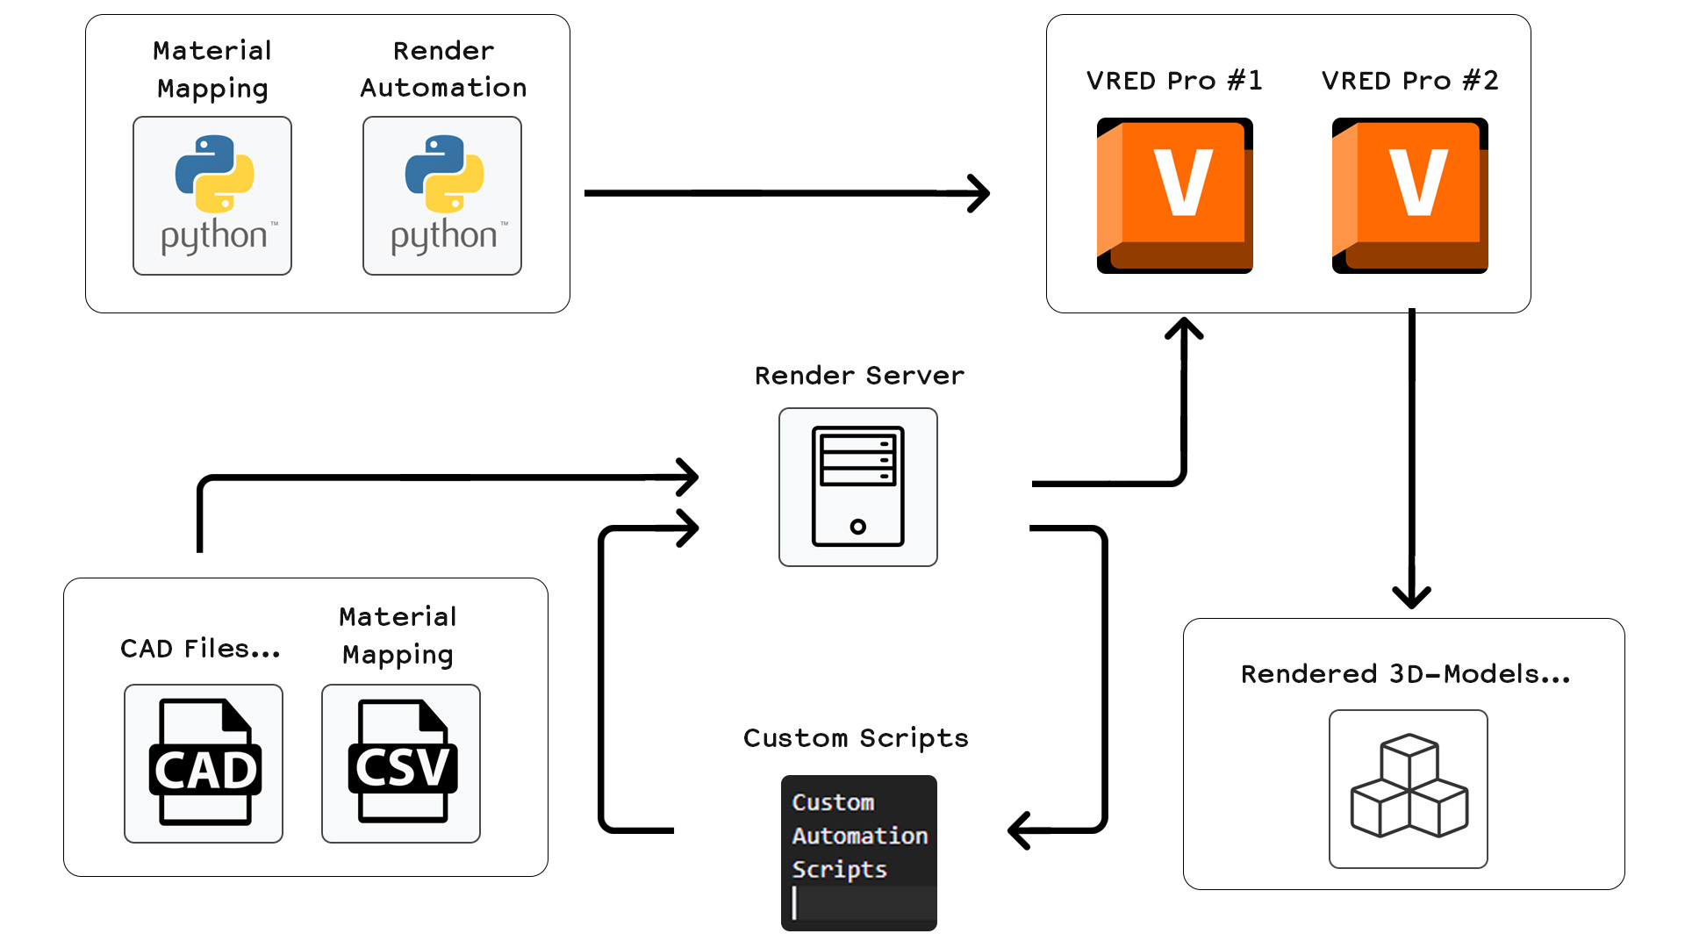
Notes:
There are different approaches to setup a pipeline in VRED
Always includes Python Scripts to do the work
Control Interface (Streaming App, Script, Variantsets, etc.)
Additional Data (Lookup Tables for materials)
No solution that fits all needs, therefore can be complicated at first
Every company has other requirements
Different IT-Infrastructures
Advantage is, that it is very customizable
Not limited to shading
All kinds of optimizations are possible

